Slide 1





Authentication
Mechanism
Giorgi Iashvili
Tbilisi, 2022

Slide 2

Overview
practice with JWT
practice with BURP
DirBuster
GoBuster
DirSearch
Machine: authorization

Slide 3
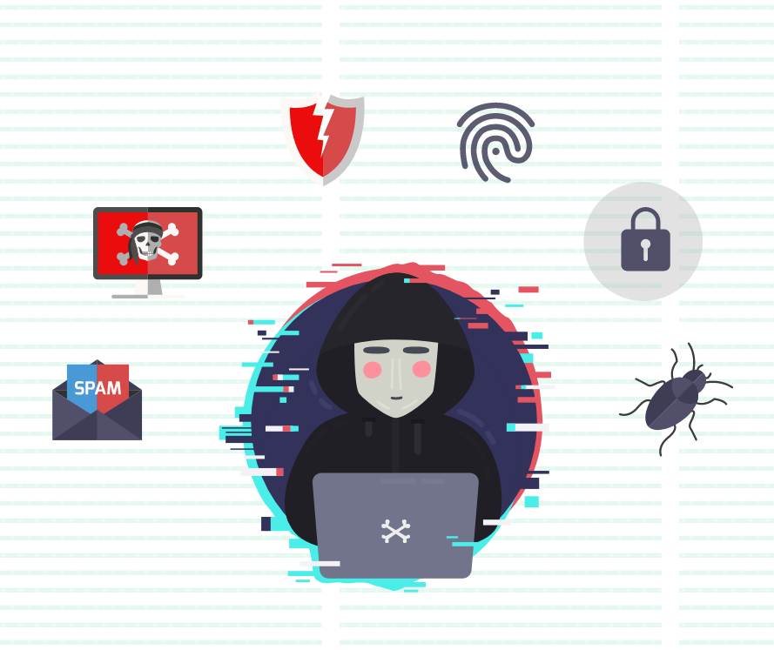
Terms & Conditions
For Educational Purposes Only
In either case,
hacking without a customer’s explicit permission and direction
is a crime.

Slide 4
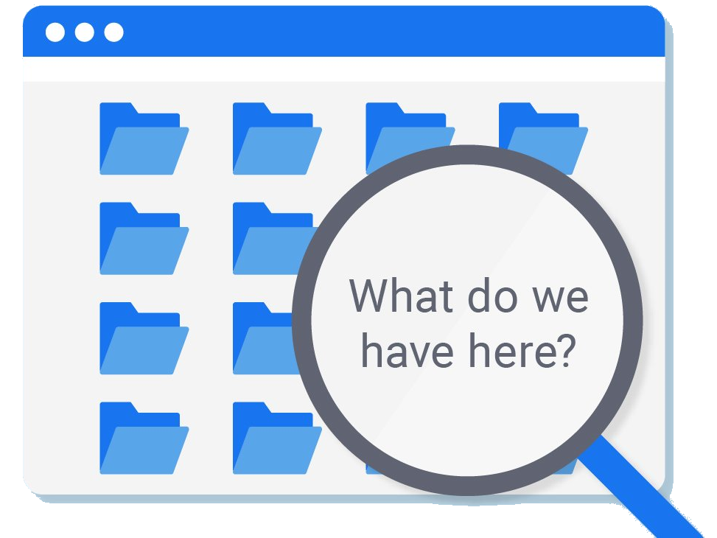
Find Hidden Web Directories
One of the first steps when pentesting a website should be scanning for hidden directories.
It is essential for finding valuable information or potential attack vectors that might otherwise be unseen on the public-facing site.
There are many tools out there that will perform the brute-forcing process, but not all are created equally.

Slide 5
Find Hidden Web Directories
DirBuster is often thought of as the de facto brute-force scanner, but it is written in Java and only offers a GUI, which can make it sort of clunky.
Dirsearch is command-line only, and having been written in Python makes it easier to integrate into scripts and other existing projects.
DIRB is another popular directory scanner, but it lacks multithreading, making dirsearch the clear winner when it comes to speed.
Gobuster - The main advantage Gobuster has over other directory scanners is speed.

Slide 6
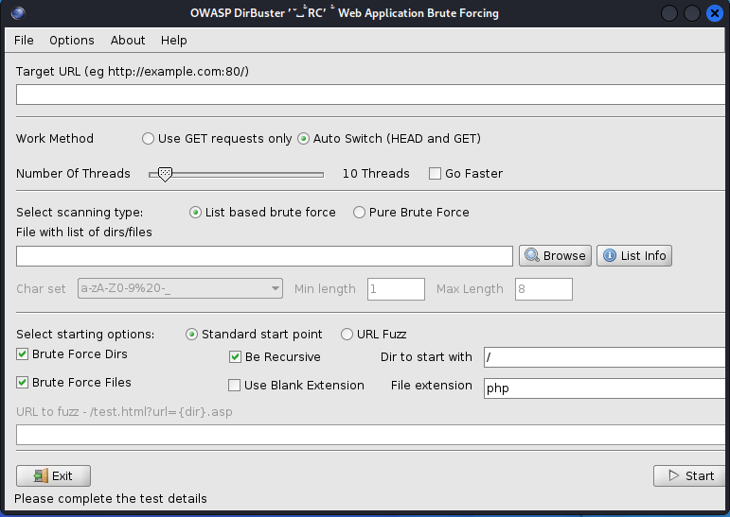
DirBuster
How DirBuster Works
DirBuster's methods are really quite simple. You point it at a URL and a port (usually port 80 or 443) and then you provide it with a wordlist (it comes with numerous—you only need to select which one you want to use). It then sends HTTP GET requests to the website and listens for the site's response.
If the URL elicits a positive response (in the 200 range), it knows the directory or file exists. If it elicits a "forbidden" request, we can probably surmise that there is a directory or file there and that it is private. This may be a file or directory we want to target in our attack.

Slide 7
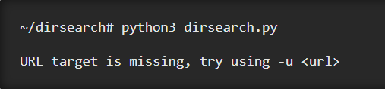
Installing Dirsearch
The first thing we need to do is install dirsearch from GitHub.
The easiest way to do this is with git. So if it's not already installed on your system, do so with the following command in the terminal:
$sudo apt-get update
$sudo apt-get install git
Now we can use the git clone command to clone the directory where the tool is located:
$git clone https://github.com/maurosoria/dirsearch
$cd dirsearch/
$python3 dirsearch.py #run dirsearch
git clone https://github.com/maurosoria/dirsearch.git --depth 1

Slide 8
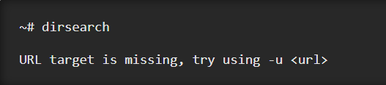
Installing Dirsearch
Run Dirsearch Using a Symbolic Link
The last way to run dirsearch, which is my preferred method, is to create a symbolic link in the /bin directory. This will allow us to run the tool from anywhere, as opposed to only in the directory cloned from GitHub.
$cd /bin/
create a symbolic link to the tool using the ln -s command:
$sudo ln -s ~/dirsearch/dirsearch.py dirsearch
Here we are naming it dirsearch, so when we run dirsearch now in the terminal, the tool will be able to run from any directory.

Slide 9
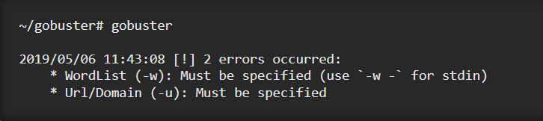
GoBuster
The main advantage Gobuster has over other directory scanners is speed.
As a programming language, Go is known to be fast. It also has excellent support for concurrency so that Gobuster can take advantage of multiple threads for faster processing.
The one downfall of Gobuster, though, is the lack of recursive directory searching. For directories more than one level deep, another scan will be needed, unfortunately.
Often this isn't that big of a deal, and other scanners can step up and fill in the gaps for Gobuster in this area.
Install Gobuster
The first thing we can do is create a working directory to keep things neat, then change into it.
$mkdir gobuster
$cd gobuster/
$sudo apt-get install gobuster
Go (also called Golang or Go language) is an open source programming language used for general purpose. Go was developed by Google engineers to create dependable and efficient software. Most similarly modeled after C, Go is statically typed and explicit.

Slide 10
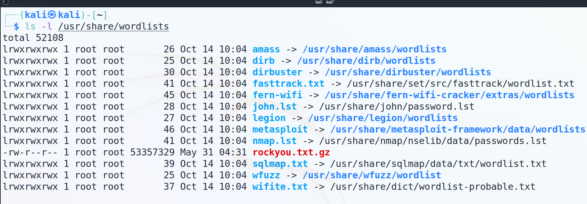
Install Some Extra Wordlists
Wordlists on Kali are located in the /usr/share/wordlists directory.

Slide 11
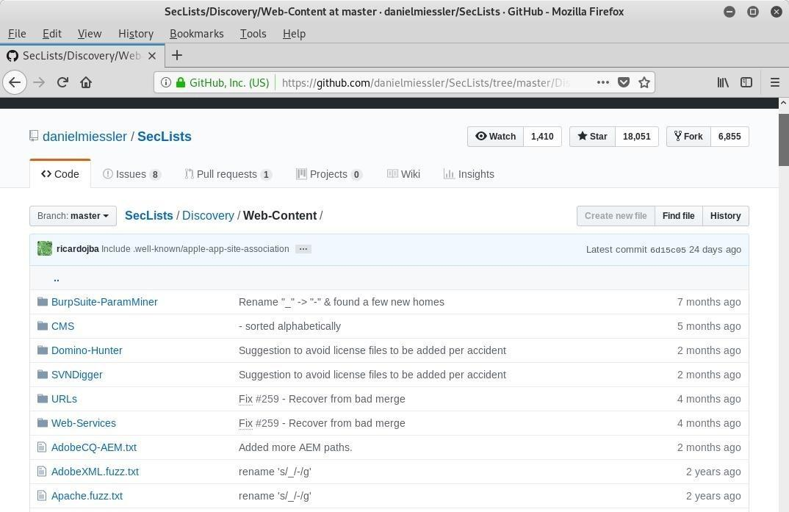
Install Some Extra Wordlists
There is a whole repository of useful wordlists on GitHub called SecLists.
The "common.txt" wordlist contains a good number of common directory names.
We can download the raw file into our current directory using the wget utility.
$wget – file_full_name
Alternatively, if we wanted to install the whole SecLists repository, we can do so with the package manager.
$sudo apt-get install seclists

Slide 12
JSON Web Tokens

Slide 13

What is JSON Web Token?
JSON Web Token (JWT) is an open standard (RFC 7519) that defines a compact and self-contained way for securely transmitting information between parties as a JSON object.
This information can be verified and trusted because it is digitally signed. JWTs can be signed using a secret (with the HMAC algorithm) or a public/private key pair using RSA or ECDSA.

Slide 14
When should you use JSON Web Tokens?
Authorization: This is the most common scenario for using JWT. Once the user is logged in, each subsequent request will include the JWT, allowing the user to access routes, services, and resources that are permitted with that token.
Information Exchange: JSON Web Tokens are a good way of securely transmitting information between parties. Because JWTs can be signed—for example, using public/private key pairs—you can be sure the senders are who they say they are.
Additionally, as the signature is calculated using the header and the payload, you can also verify that the content hasn't been tampered with.

Slide 15
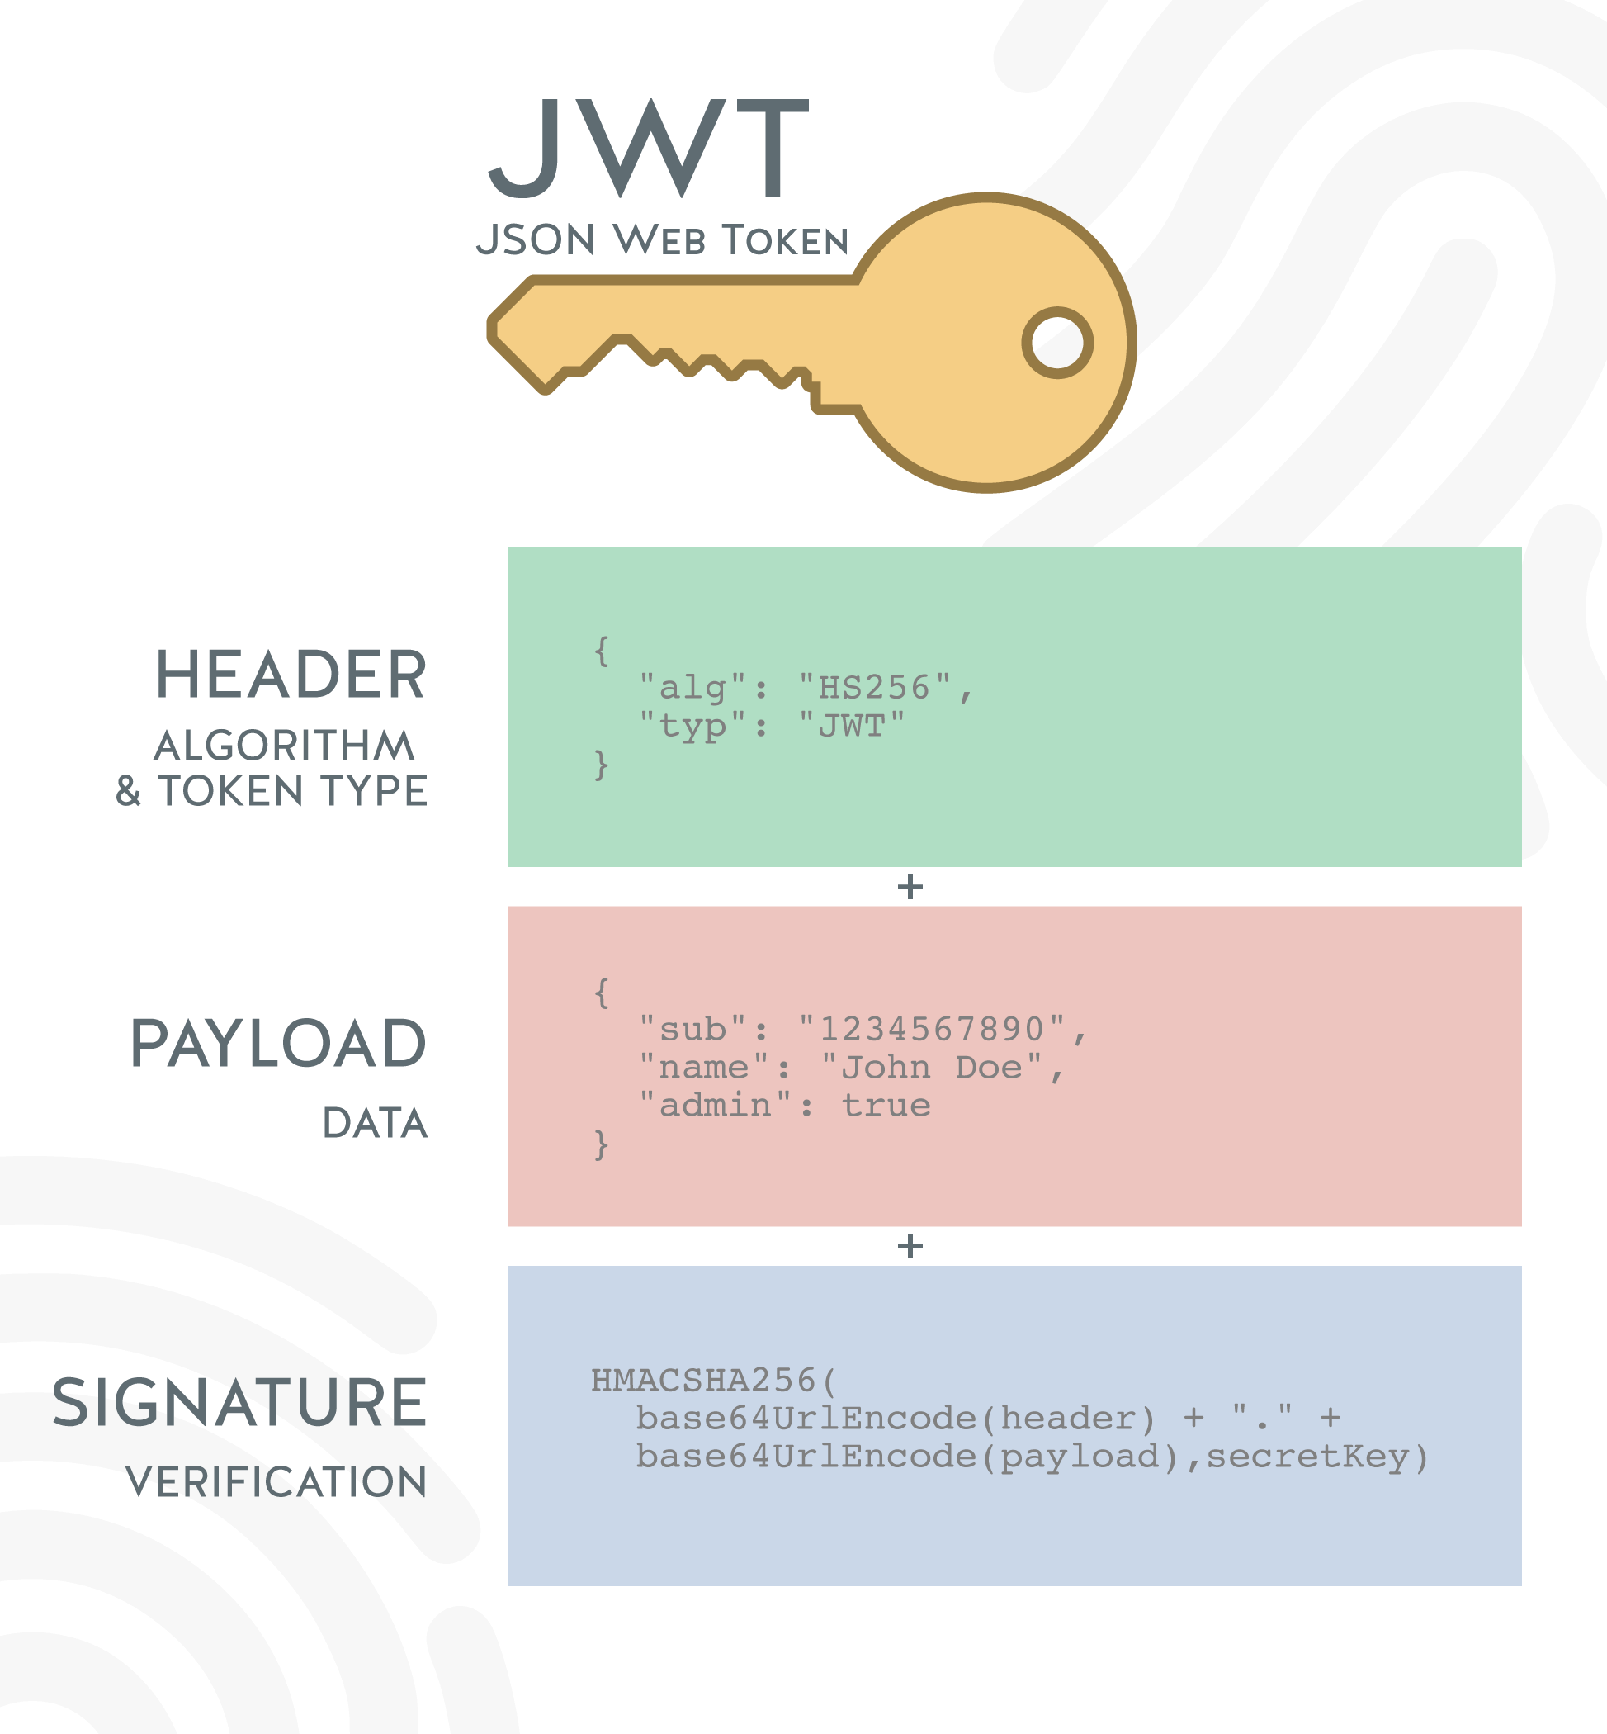
What is the JSON Web Token structure?
In its compact form, JSON Web Tokens consist of three parts separated by dots (.), which are:
Header
Payload
Signature
Therefore, a JWT typically looks like the following.
xxxxx.yyyyy.zzzzz

Slide 16
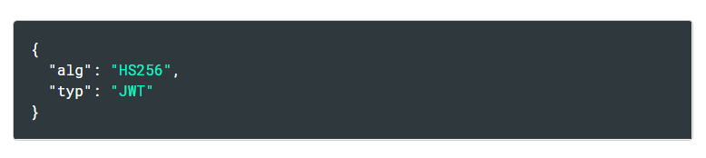
Header
The header typically consists of two parts: the type of the token, which is JWT, and the signing algorithm being used, such as HMAC SHA256 or RSA.
Then, this JSON is Base64Url encoded to form the first part of the JWT.

Slide 17
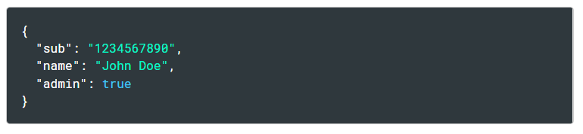
Payload
The second part of the token is the payload, which contains the claims. Claims are statements about an entity (typically, the user) and additional data.

Slide 18
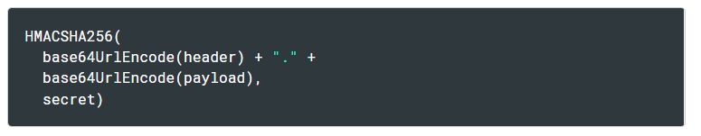
Signature
To create the signature part you have to take the encoded header, the encoded payload, a secret, the algorithm specified in the header, and sign that.
For example if you want to use the HMAC SHA256 algorithm, the signature will be created in the following way:
Hash-based message authentication code - HMAC

Slide 19
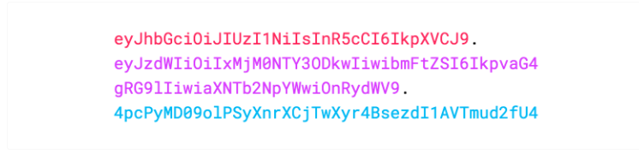
Putting all together
The output is three Base64-URL strings separated by dots that can be easily passed in HTML and HTTP environments, while being more compact when compared to XML-based standards such as SAML. The following shows a JWT that has the previous header and payload encoded, and it is signed with a secret.
If you want to play with JWT and put these concepts into practice, you can use jwt.io

Slide 20
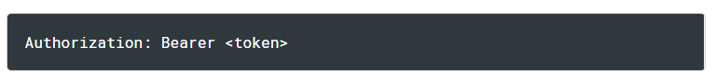
How do JSON Web Tokens work?
In authentication, when the user successfully logs in using their credentials, a JSON Web Token will be returned. Since tokens are credentials, great care must be taken to prevent security issues. In general, you should not keep tokens longer than required.
Whenever the user wants to access a protected route or resource, the user agent should send the JWT, typically in the Authorization header using the Bearer schema. The content of the header should look like the following:

Slide 21
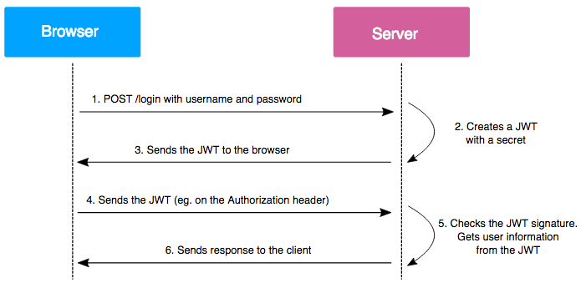
How do JSON Web Tokens work?
The application or client requests authorization to the authorization server. This is performed through one of the different authorization flows. For example, a typical OpenID Connect compliant web application will go through the /oauth/authorize endpoint using the authorization code flow.
When the authorization is granted, the authorization server returns an access token to the application.
The application uses the access token to access a protected resource (like an API).
Do note that with signed tokens, all the information contained within the token is exposed to users or other parties, even though they are unable to change it. This means you should not put secret information within the token.

Slide 22
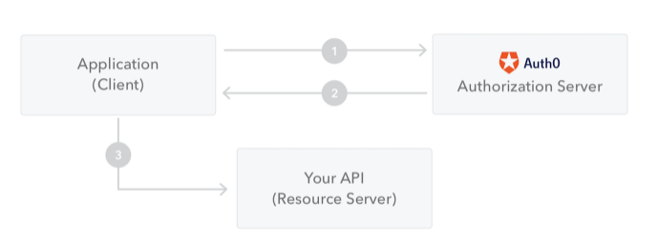
How do JSON Web Tokens work?
If the token is sent in the Authorization header, Cross-Origin Resource Sharing (CORS) won't be an issue as it doesn't use cookies. The following diagram shows how a JWT is obtained and used to access APIs or resources:

Slide 23
Why should we use JSON Web Tokens?
Let's talk about the benefits of JSON Web Tokens (JWT) when compared to Simple Web Tokens (SWT) and Security Assertion Markup Language Tokens (SAML).
As JSON is less verbose than XML, when it is encoded its size is also smaller, making JWT more compact than SAML. This makes JWT a good choice to be passed in HTML and HTTP environments.

Slide 24
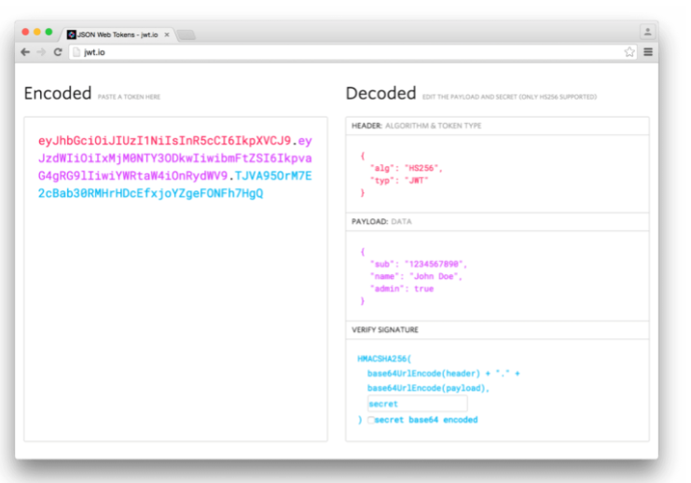
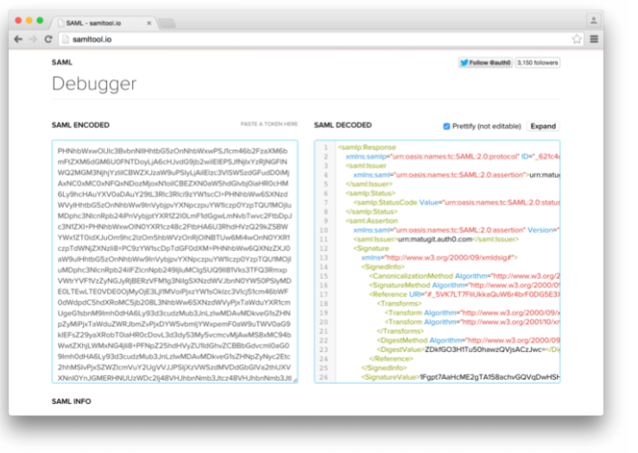
Comparison of the length of an encoded JWT and an encoded SAML

Slide 25
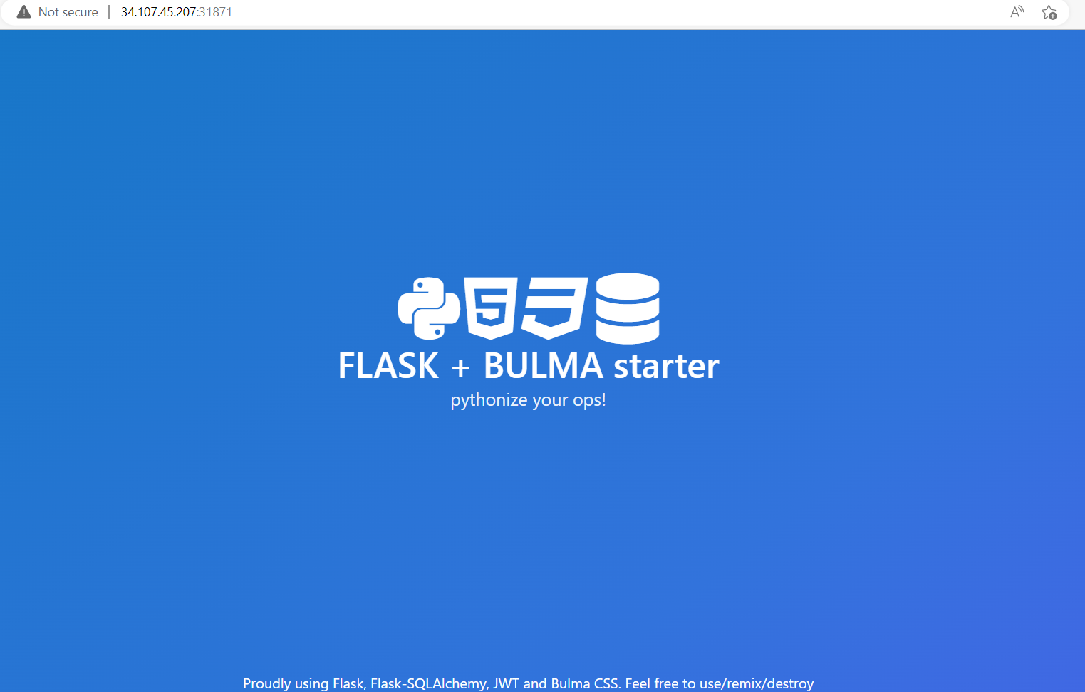
Laboratory: authorization
Description:
Can you be a master of recon!
Flag format: CTF{sha256}
Level: Medium
Server: 34.107.45.207:31871
Hints:
Hint 1: Try to find yourself ^^

Slide 26
Laboratory: authorization
? ? ?

Slide 27
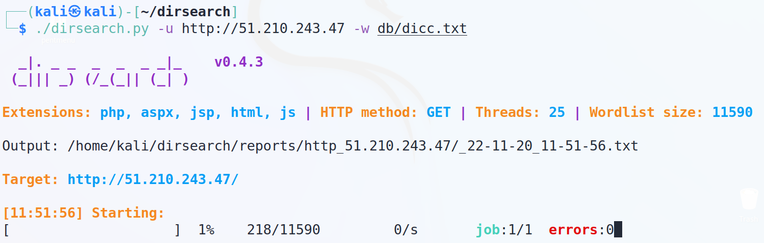
Laboratory: authorization

Slide 28
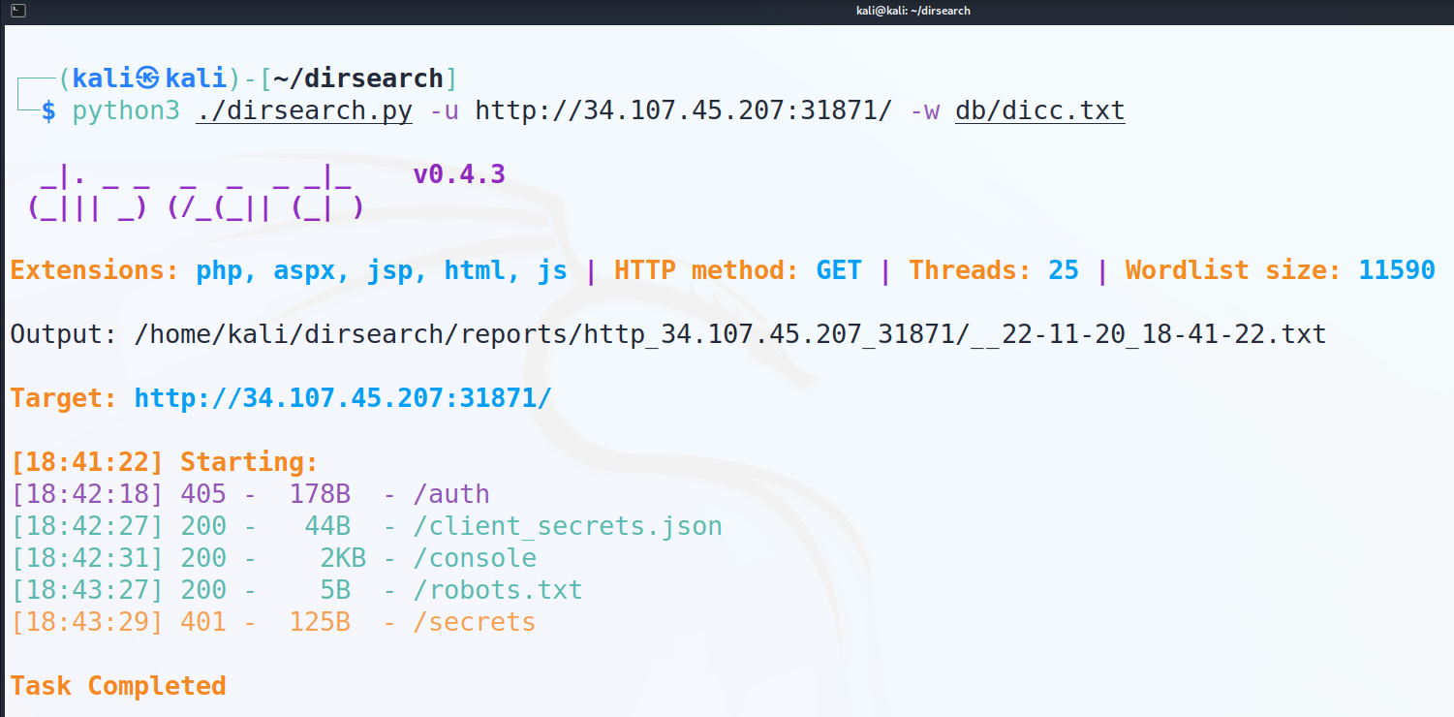
Laboratory: authorization

Slide 29
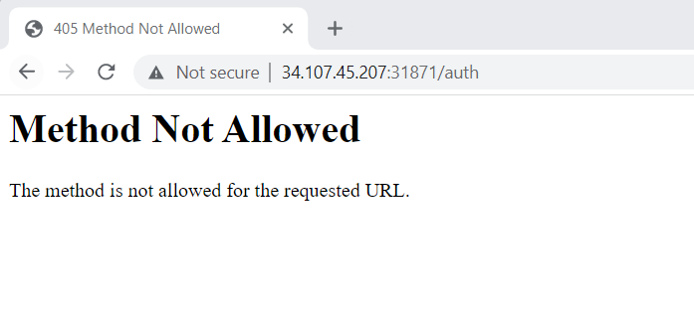
Laboratory: authorization
We got some routes: /auth, /client_secrets.json, /robots.txt, /secrets.
Let’s check the firstroute.

Slide 30
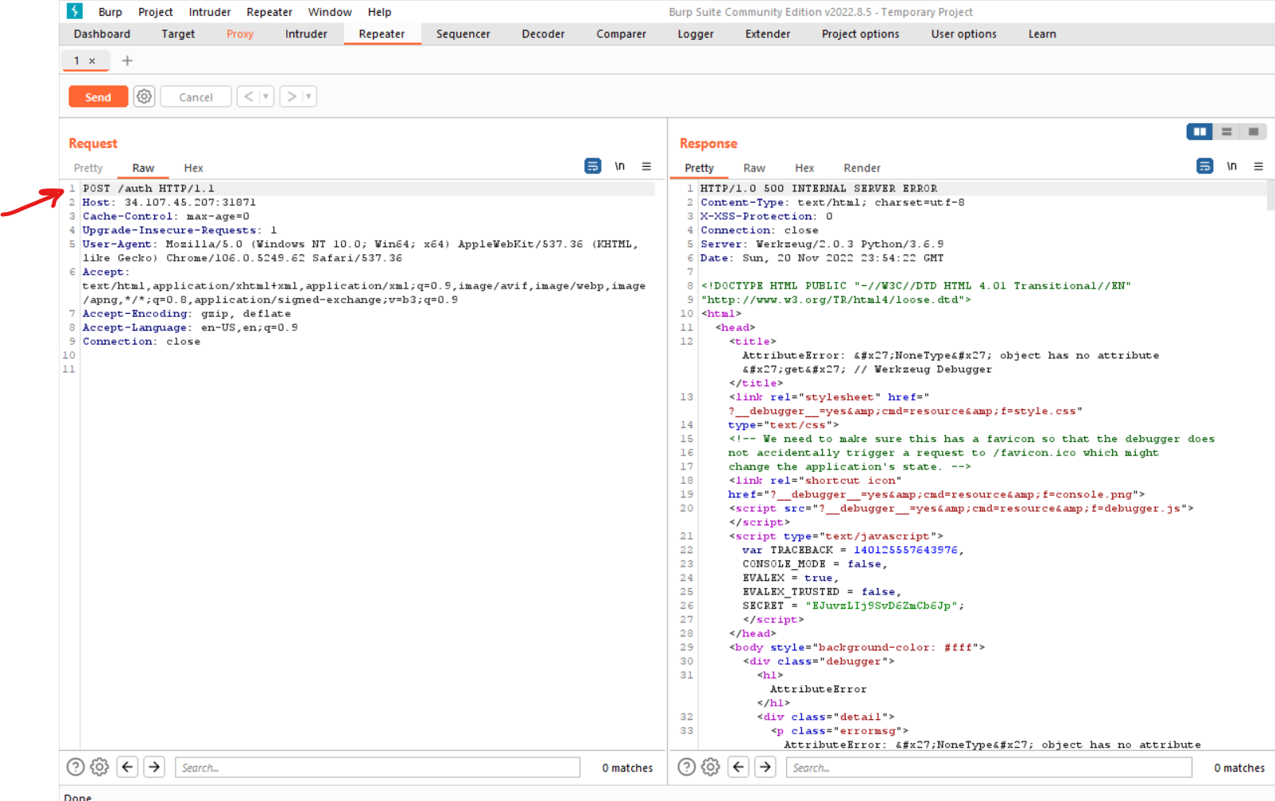
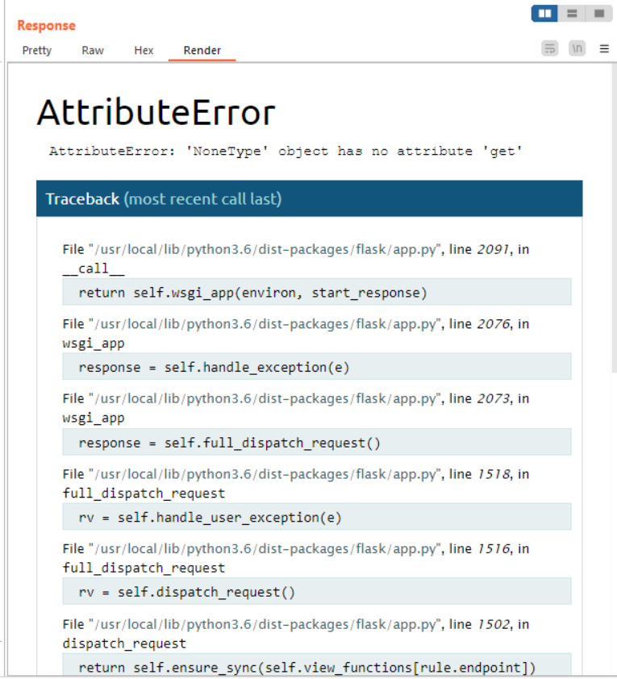
Laboratory: authorization
We are not allowed to use GET requests because we got some error,
so let’s try to use POST requests.

Slide 31
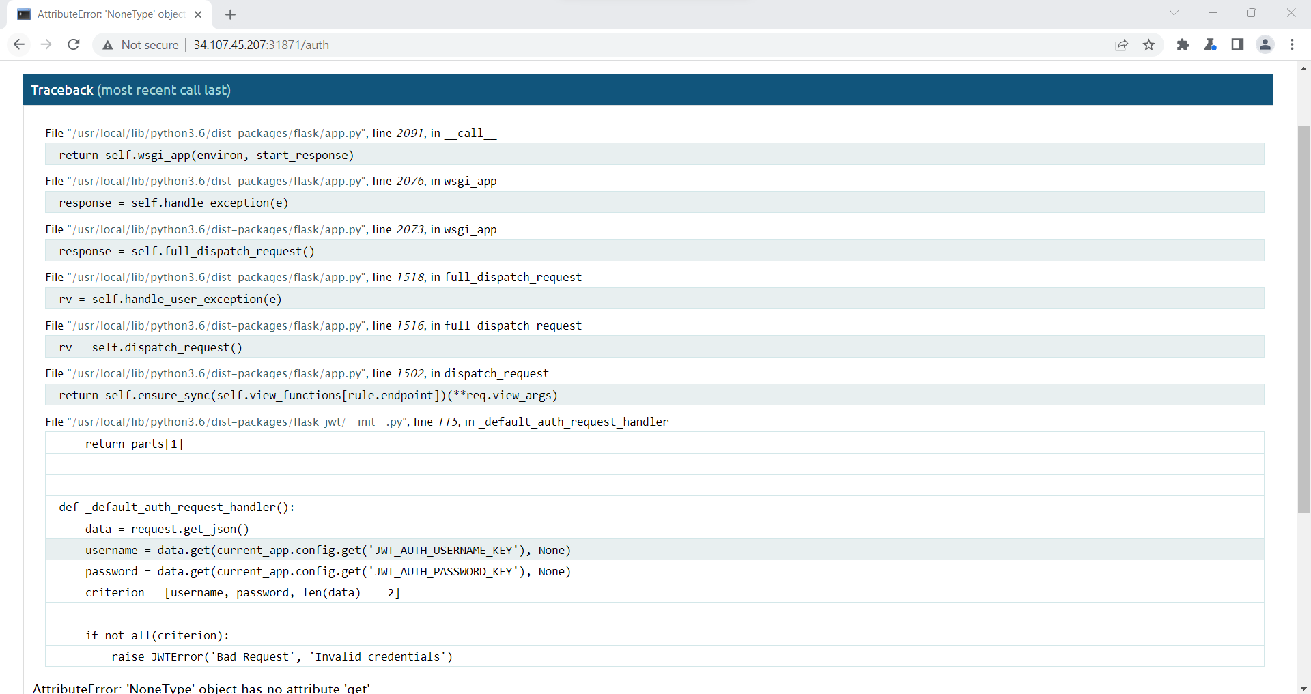
Laboratory: authorization
At this moment we can notice some flask errors that are triggered.
But we notice some strange parameters such as: (JWT_AUTH_USERNAME_KEY and
JWT_AUTH_PASSWORD_KEY) which are in json format
(keep in mind data is in json
format).

Slide 32
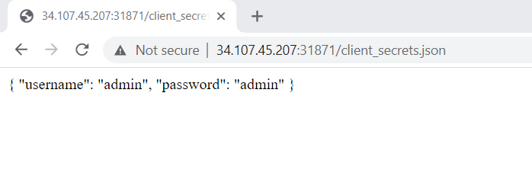
Laboratory: authorization
We need to get users credentials to do some requests on this page.
For this point let’s check another interesting route: /client_secrets.json.
After this step, we obtain the user credentials, but we don’t have the JWT_AUTH token for what
we got. Let's go back to the /auth route and try again to do a POST request with the credentials obtained above.

Slide 33
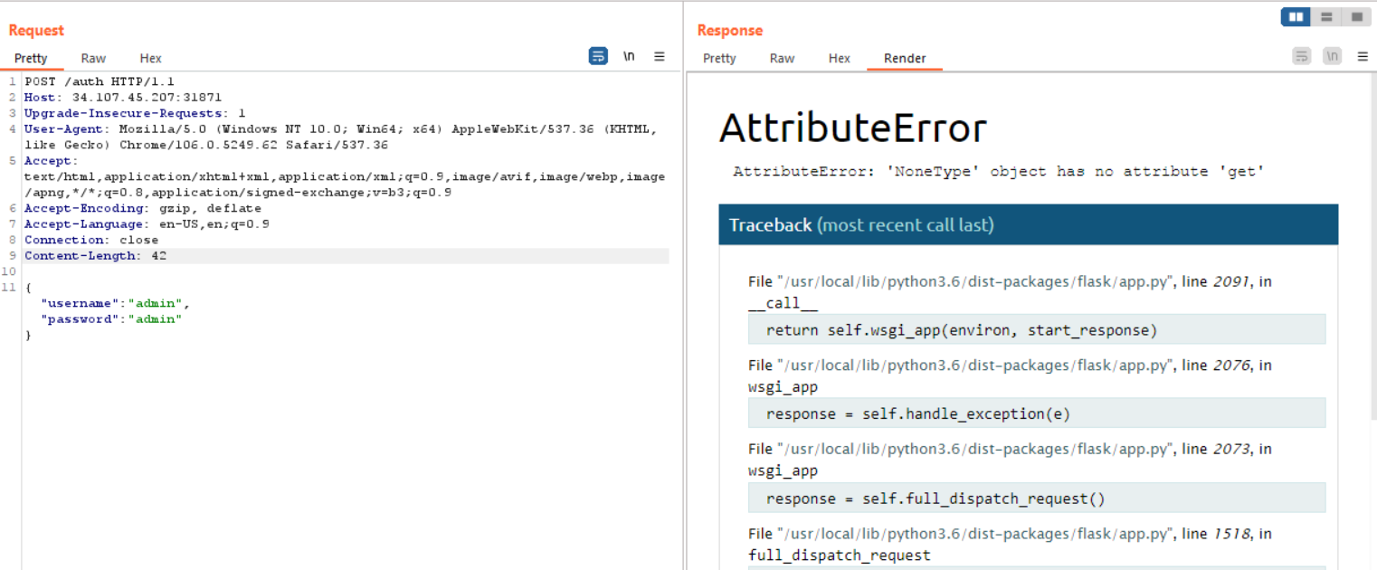
Laboratory: authorization
Don’t miss to add content type (our data is in JSON format):

Slide 34
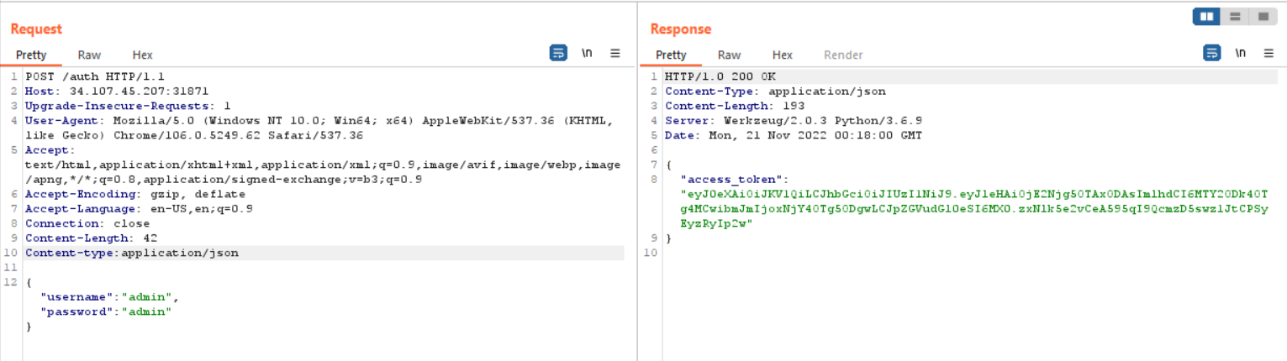
Laboratory: authorization
Now let's go to the secret route and add the JWT token authorization to get the flag.

Slide 35
Laboratory: authorization
Now let's go to the secret route and add the JWT token authorization to get the flag.

Slide 36
Laboratory: authorization
Now let's go to the secret route and add the JWT token authorization to get the flag.

Slide 37
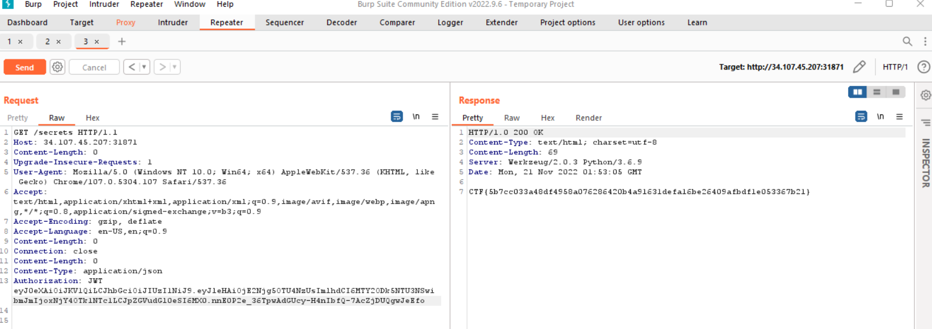
Laboratory: authorization

Slide 38
Thank you for Attention!

